Slide 1
Python Data Types
• Integers: Whole numbers (e.g., 5, -10)
• Floats: Decimal numbers (e.g., 3.14, -0.01)
• Strings: Text data (e.g., 'hello', "Python")
• Lists: Ordered, mutable collection (e.g., [1, 2, 3])
• Tuples: Ordered, immutable collection (e.g., (1, 2))
• Dictionaries: Key-value pairs (e.g., {'a': 1})
• Sets: Unordered, unique items (e.g., {1, 2, 3})

Slide 2
Variables and Memory Allocation
• Variables store references to objects
• No need to declare type explicitly
• Dynamic typing: type can change during execution
• Memory managed by Python’s garbage collector
• Use meaningful variable names

Slide 3
Python Operators
• Arithmetic: +, -, *, /, %, **, //
• Comparison: ==, !=, >, <, >=, <=
• Logical: and, or, not
• Bitwise: &, |, ^, ~, <<, >>
• Assignment: =, +=, -=, *=, etc.

Slide 4
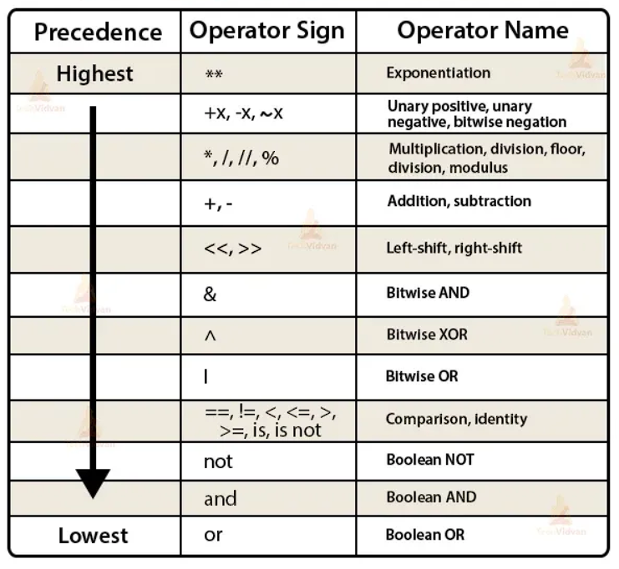
Python Precedence Order of Operators

